Slide 1
BASIC OPERATORS
Introduction to programming – Nhập môn lập trình
Trương Toàn Thịnh

Slide 2
CONTENTS
Introduction
Data type, constant & variable
Primitive data-types
Library
I/O formatting
Exercises

Slide 3
INTRODUCTION
Example
Lines | C++ | C
1 | //File Hello.cpp | //File Hello.c
2 | #include <iostream> | #include <stdio.h>
3 | using namespace std;
4 | void main() | void main()
5 | { | {
6 | cout<<“Hello World!!!”<<endl; | printf(“Hello World!!!\n”);
7 | } | }

Slide 4
INTRODUCTION
Line 2: library iostream in C++ supports input/output (similar to scanf & printf)
Line 3: using ‘namespace std’ to invoke cout (maybe typing std::cout without it)
Line 6: using cout to print “Hello world” with operator called “endl” similar to ‘\n’

Slide 5
CONTENTS
Introduction
Data type, constant & variable
Primitive data-types
Library
I/O formatting
Exercises

Slide 6
DATATYPE, CONSTANT & VARIABLE
Datatype
  C supports
    Character (char): such as ‘a’ or ‘b’
    Integer number (int, long): such as 23 or 24L
    Single – precision floating point (float): such as 1.2F or 2.2F
    Double – precision floating point (double): such as 1.2 or 2.2
  Every datatype has min & max values
  Character & integer number can be used interchangeably
    Ex: char a = 65
  Integer number may be signed or non-signed

Slide 7
DATATYPE, CONSTANT & VARIABLE
Constant: quantity with unchangeable values
  Character constant: ‘a’, ‘b’
  Integer number constant: 22, 22L
  Real number constant: 1.2, 1.2F
  String constant: “hello”
Defining constant: giving to 3.14 the name PI
  #define PI 3.14 (C language)
  const int PI 3.14; (C++ language)
High address
STACK
HEAP
UNINITIALIZED DATA
INITIALIZED DATA
Low address
TEXT

Slide 8
DATATYPE, CONSTANT & VARIABLE
Variable: quantity with changeable values
  Ex: int a, char c, float f…
Naming conventions:
  Descriptive: int dienTich, char kt…
  Starting with A → Z, underscore _
  Obeying contracts
Showing datatype’s size with sizeof operator: it takes variable’s name or datatype as input (unit: byte)
  Ex: sizeof(int) (equal to 4 bytes), sizeof(c) (equal to 1 byte)
High address
STACK
HEAP
UNINITIALIZED DATA
INITIALIZED DATA
Low address
TEXT

Slide 9
DATATYPE, CONSTANT & VARIABLE
Example
Lines | Description
1 | //File Circle.c
2 | #include <stdio.h>
3 | void main()
4 | {
5 | #define PI 3.14159
6 | float R = 1.25;
7 | float DienTich;
8 | DienTich = PI*R*R;
9 | printf(“Hinh tron, ban kinh = %f\n”, R);
10 | printf(“Dien tich = %f”, DienTich);
11 | }

Slide 10
DATATYPE, CONSTANT & VARIABLE
Line 5: giving to 3.14 the name PI
Line 6: Declare & define float var R 1.25
Line 7: Declare float var DienTich
Line 8: Calculating area, then assigning that value to var DienTich
Line 9 & 10: Sending the result to standard output (screen)

Slide 11
DATATYPE, CONSTANT & VARIABLE
Example
Lines | Description
1 | //File varSize.c
2 | #include <stdio.h>
3 | void main()
4 | {
5 | short Delta = 9;
6 | printf(“Kich thuoc delta = %d\n”, sizeof(delta));
7 | printf(“Kich thuoc kieu int = %d\n”, sizeof(int));
8 | printf(“Kich thuoc kieu long = %d\n”, sizeof(long));
9 | printf(“Kich thuoc kieu float = %d\n”, sizeof(float));
10 | printf(“Kich thuoc kieu char = %d\n”, sizeof(char));
11 | }

Slide 12
DATATYPE, CONSTANT & VARIABLE
The three basic steps of the Problem-Solving Process
  Input data
  Process data
  Output data
Some notations used in flowchart
: Start/End
: Input/output
: Process

Slide 13
CONTENTS
Introduction
Data type, constant & variable
Primitive data-types
Library
I/O formatting
Exercises

Slide 14
PRIMITIVE DATA – TYPES
Integer number:
  char: signed 8-bit characters ∈ [-128, 127]
  unsigned char: unsigned 8-bit characters ∈ [0, 255]
  int: signed 32-bit integers ∈ [-2³¹, 2³¹ – 1]
  unsigned int: unsigned 32-bit integers ∈ [0, 2³²- 1)
  short: signed 16-bit integers ∈ [-32768, 32767]
  unsigned short: unsigned 16-bit integers ∈ [0, 65535]
Operators: +, -, ×, ÷, %
Representations:
  Decimal (dec): 15₁₀
  Binary (bin): 1111₂
  Hexadecimal (hex): 0xF
  Octal (oct): 17₈

Slide 15
PRIMITIVE DATA – TYPES
Example: signed 16–bit integer
  Negative number (first bit is 1)
  1×××××××××××××××
  000000000000000
  000000000000001
  000000000000010
  …
  111111111111111
2¹⁵ numbers

Slide 16
PRIMITIVE DATA – TYPES
Example: signed 16-bit integer
  Positive (first bit is 0)
  0×××××××××××××××
  000000000000000
  000000000000001
  000000000000010
  …
  111111111111111
2¹⁵ – 1 numbers

Slide 17
PRIMITIVE DATA – TYPES
Operators in integer:
  A = 10₁₀ (1010₂) & B = 15₁₀ (1111₂)
  A & B = (1010₂) & (1111₂) = 1010₂ (10₁₀)
  A | B = (1010₂) | (1111₂) = 1111₂ (15₁₀)
  A ^ B = (1010₂) ^ (1111₂) = 0101₂ (5₁₀)
  ~A = ~(1010₂) = ~(00001010₂) = (11110101₂) = -11 (Remember ~(n) = -n-1)
  A << 1 = (00001010₂) << 1 = (00010100₂) = 20₁₀
  A >> 1 = (00001010₂) >> 1 = (00000101₂) = 5₁₀
Consider some cases:
  unsigned char c = -1; // c = 255 = -1 + 256
  char b = -129; // b = 127 = -129 + 256
  char a = 128; // a = -128 = 128 – 256

Slide 18
PRIMITIVE DATA – TYPES
There are 2 floating points
  float: sized 4-byte, with values ∈ [1.401298×10⁻⁴⁵, 3.40282×10³⁸]
  double: sized 8-byte, with values ∈ [4.94066×10⁻³²⁴, 1.79769×10³⁰⁸]
Operators: +, -, ×, ÷
Example: consider 209.8125F
  209₁₀ = 11010001₂
  0.8125 × 2 → 1.625 × 2 → 1.25 × 2 → 0.5 × 2 → 1.0: vậy 0.8125 = 0.1101
  So 209.8125 = 11010001.1101₂
  Normalize to ‘1.F’: 1.10100011101 (Move ‘.’ to left 7 positions).
  Compute 7 + 127 = 134 = 10000110₂ (using 127-EXCESSIVE)
  Finally we have
  31 30 23 22 0
  0 1 0 0 0 0 1 1 0 1 0 1 0 0 0 1 1 1 0 1 0 0 0 0 0 0 0 0 0 0 0 0

Slide 19
PRIMITIVE DATA – TYPES
Logical: special type in C/C++
There are 2 values {true (≠ 0), false (0)}
Operators:
  &&: (A && B) true if A and B are true
  ||: (A || B) false if A andB are false
  !: (!B) là true if B false and vice versa

Slide 20
PRIMITIVE DATA – TYPES
Example
Lines | Description
1 | #include <stdio.h>
2 | void main(){
3 | bool bVal;
4 | float x = 46.7F, y = 93F, z;
5 | bVal = (x == y);
6 | printf(“%d\n”, bVal);
7 | bVal = (x < y);
8 | printf(“%d\n”, bVal);
9 | z = (x > y)*x + (x <= y)*y;
10 | printf(“%f\n”, z);
11 | }

Slide 21
PRIMITIVE DATA – TYPES
There are 2 character types
  8-bit character: char or unsigned char
  16-bit character: wchar_t (Note: this type is reserved for unsigned 16-bit characters)
Example: char c = ‘a’; wchar_t d = L‘a’;
8-bit characters ∈ [0, 255] = ASCII
16-bit characters follow Unicode
Using comparison operators and (+, -) with character type

Slide 22
PRIMITIVE DATA – TYPES
Example (character type)
Lines | Description
1 | #include <stdio.h>
2 | void main(){
3 | char ch = 65;
4 | printf(“%c\n”, ch);
5 | ch = ‘A’;
6 | printf(“%c\n”, ch);
7 | printf(“Nhap ch: ”);
8 | scanf(“%c”, &ch);
9 | printf(“ASCII code: %d\n”, ch);
10 | ch -= (‘a’ – ‘A’)*(ch >= ‘a’ && ch <= ‘z’);
11 | printf(“Upper case: %c\n”, ch);
12 | }

Slide 23
PRIMITIVE DATA – TYPES
Assignment:
  a = b: The value b holds is assigned to a (value b holds is equal to value a holds)
  a = b = c: …
  a = a + 1: value a holds increase by one, then assigning back to itself (value a holds increase by one)
  a++:…
  ++a:…
  a = b++: Assigning b to a, then increasing b by one
  a = ++b: Increassing b by one, then assigning just – increased b to a

Slide 24
PRIMITIVE DATA – TYPES
Size & precision:
  Datatype has a limited size
  Example: consider 2 short integers
  short a = 400, b = 500, z;
  z = a*b; // z = 3392 = 200000 mod 2¹⁶
  When floating-point numbers exceed the limit allowed, there are some strange cases:
  Example: consider float
    1.401298E-45F / 2 = 0
    3.40282E+38F + 10 = 3.40282E+38F

Slide 25
PRIMITIVE DATA – TYPES
Size & precision:
  If there is no way to express the real number, computer will approximate → incorrect
  If real number can be expressed:
  a = 1.125f
  b = 1.250f
  c = a + b = 2.375f
  If real number cannot be expressed
  a = 1.123f
  b = 1.456f
  c = a + b ≠ 2.579f
  31 30 23 22 0
  0 0 1 1 1 1 1 1 1 0 0 1 0 0 0 0 0 0 0 0 0 0 0 0 0 0 0 0 0 0 0 0
  0 0 1 1 1 1 1 1 1 0 1 0 0 0 0 0 0 0 0 0 0 0 0 0 0 0 0 0 0 0 0 0
  0 1 0 0 0 0 0 0 0 0 0 1 1 0 0 0 0 0 0 0 0 0 0 0 0 0 0 0 0 0 0 0

Slide 26
CONTENTS
Introduction
Data type, constant & variable
Primitive data-types
Library
I/O formatting
Exercises

Slide 27
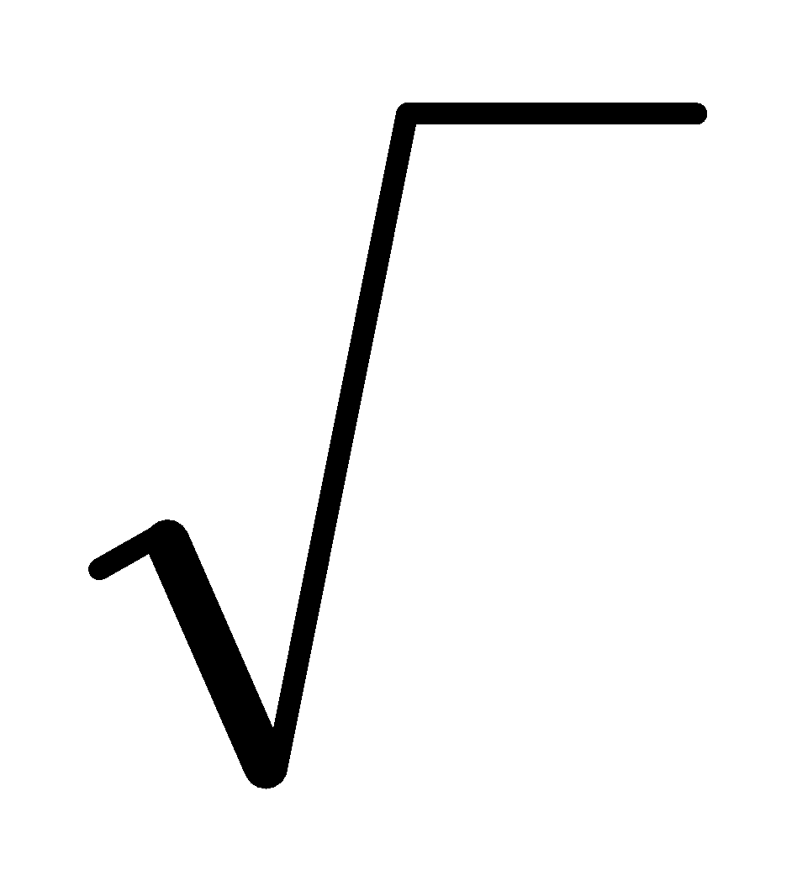
LIBRARY
Available set of functions reserved for specific goals is called library
  Examples
    <math.h>: mathematical functions
    <ctype.h>: Character functions
Function is a set of statements that take inputs, do some specific computation and produces output
  Example of sqrt(double):
    Input: a double – precision floating point number
    Output: result of square root

Slide 28
LIBRARY
Some functions for char/wchar_t
int isupper(char) int iswupper(wchar_t) | Check if input character is capitalized
char toupper(char) wchar_t towupper(wchar_t) | Return capitalized character corresponding to non-capital input character
int islower(char) int iswlower(wchar_t) | Check if input character is non-capital
char tolower(char) wchar_t towlower(wchar_t) | Return non-capital character corresponding to input capitalized character

Slide 29
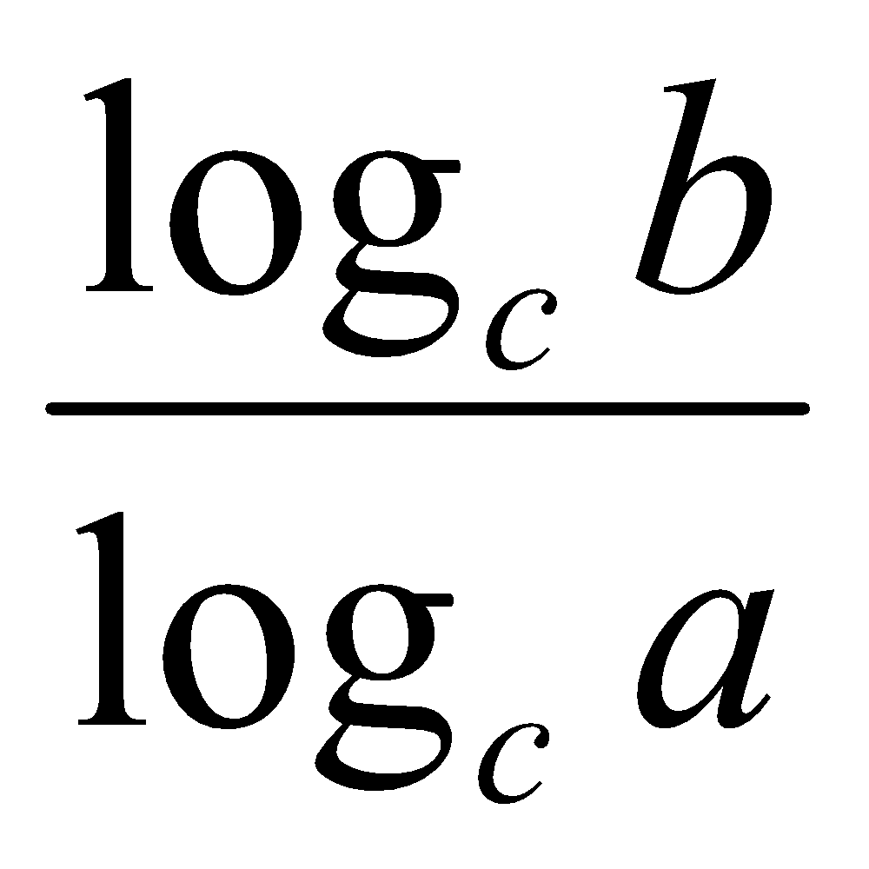
LIBRARY
Example: computing y = log₂8
Note: log_{a}b =
Lines | Description
1 | #include <stdio.h>
2 | #include <math.h>
3 | void main(){
4 | double a = 2, b = 8, c;
5 | c = log(8)/log(2);
6 | printf(“%lf\n”, c);
7 | }

Slide 30
CONTENTS
Introduction
Data type, constant & variable
Primitive data-types
Library
I/O formatting
Exercises

Slide 31
I/O FORMATTING
Able to control the format while sending result to output device (console mode)
  Signed integer:
    Print ‘int’: using “%d”
    Print ‘long’: using “%ld”
    Print ‘short’: using “%hd”
  Unsigned integer: using “%u”
  Floating-point number ‘float’: using “%f” or “%e”
  Floating-point number ‘double’: using “%lf” or “%le”
  Character type ‘char’: using “%c”
  String type ‘char*’: using “%s”
  Radix based integer:
    Hexadecimal radix: “%x”
    Octal radix: “%o”

Slide 32
I/O FORMATTING
Example
Lines | Description
1 | #include <stdio.h>
2 | void main(){
3 | int a = 28; long b = -9; short c = 8;
4 | float d = 1.2E-8F;
5 | printf("%d\n", a);
6 | printf("%hd\n", c);
7 | printf("%ld\n", b);
8 | printf("%o\n", a);
9 | printf("%x\n", a);
10 | printf("%e\n", c);
11 | }

Slide 33
I/O FORMATTING
Able to control width and precision with integer and floating – point number
Follow as ‘<bổ từ>width.precision’ to control output width
Example for floating – point numbers:
float a = 2.335
printf(“%0.2f”, a); //2.33
Example for integer number with ‘0’:
int a = 2;
printf(“%05d”, a); //000002
Additionally, we have ‘-’ or ‘*’…

Slide 34
I/O FORMATTING
I/O formatting in C++:
  using cin and cout combined with “>>” and “<<”
  Declare
    #include <iostream>
    using namespace std;
  If using I/O format, need to declare #include <iomanip>. This library contains some operators and convenient functions
    setw(n): set width (left or right) to exactly print n characters to screen (default space inserted)
    setfill(ch): in companion with setw to print n character ‘ch’
    setprecision(n): set precision with floating–point numbers
    Additionally, we have hex, oct, endl, left, right

Slide 35
I/O FORMATTING
I/O formatting in C++:
  Example
    #include <iostream>
    #include <iomanip>
    void main(){
      int a = 970, h = 10, v = 9700;
      cout << setw(8) << “Area” << setw(10) << a << endl;
      cout << setw(8) << “H” << setw(10) << h << endl;
      cout << setw(8) << “Volume” << setw(10) << v << endl;
    }
Results:
Area 970
H 10
Volume 9700
8 chars
10 chars

Slide 36
I/O FORMATTING
I/O formatting in C++:
  Example
    #include <iostream>
    #include <iomanip>
    void main(){
      long n;
      cout << “n (hexadecimal) = ”;
      cin >> hex >> n;
      cout << “Octal representation: ” << oct << n << endl;
    }
Results:
n (hexadecimal) = 8 ↵
Octal representation: 10

